Slide 1

Funds Management (Overdrafts) Policy

Slide 2
Agenda
Background
Data Sources
Policy & Process

Slide 3
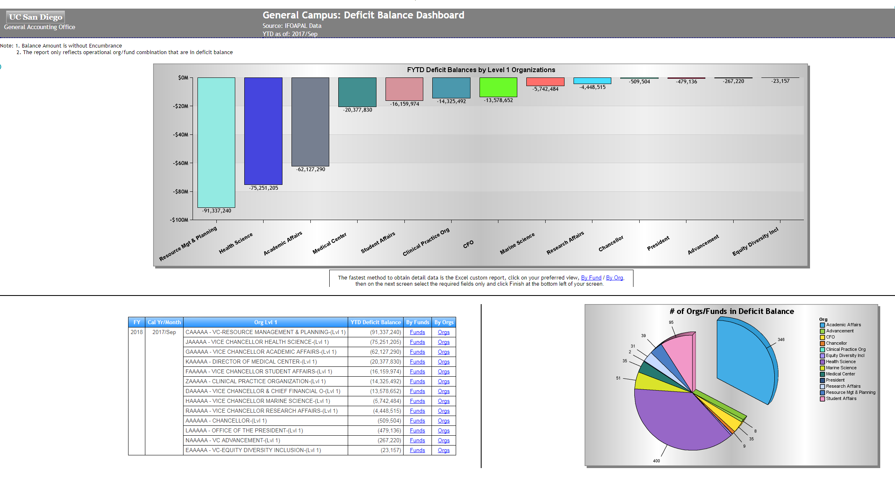
Background
Funds deficits at UC San Diego a persistent problem
Leadership focused on timely resolution
Two Pronged Approach
  Consistent Measures (Deficit Balance Analytics)
  Definitive Policy

Slide 4
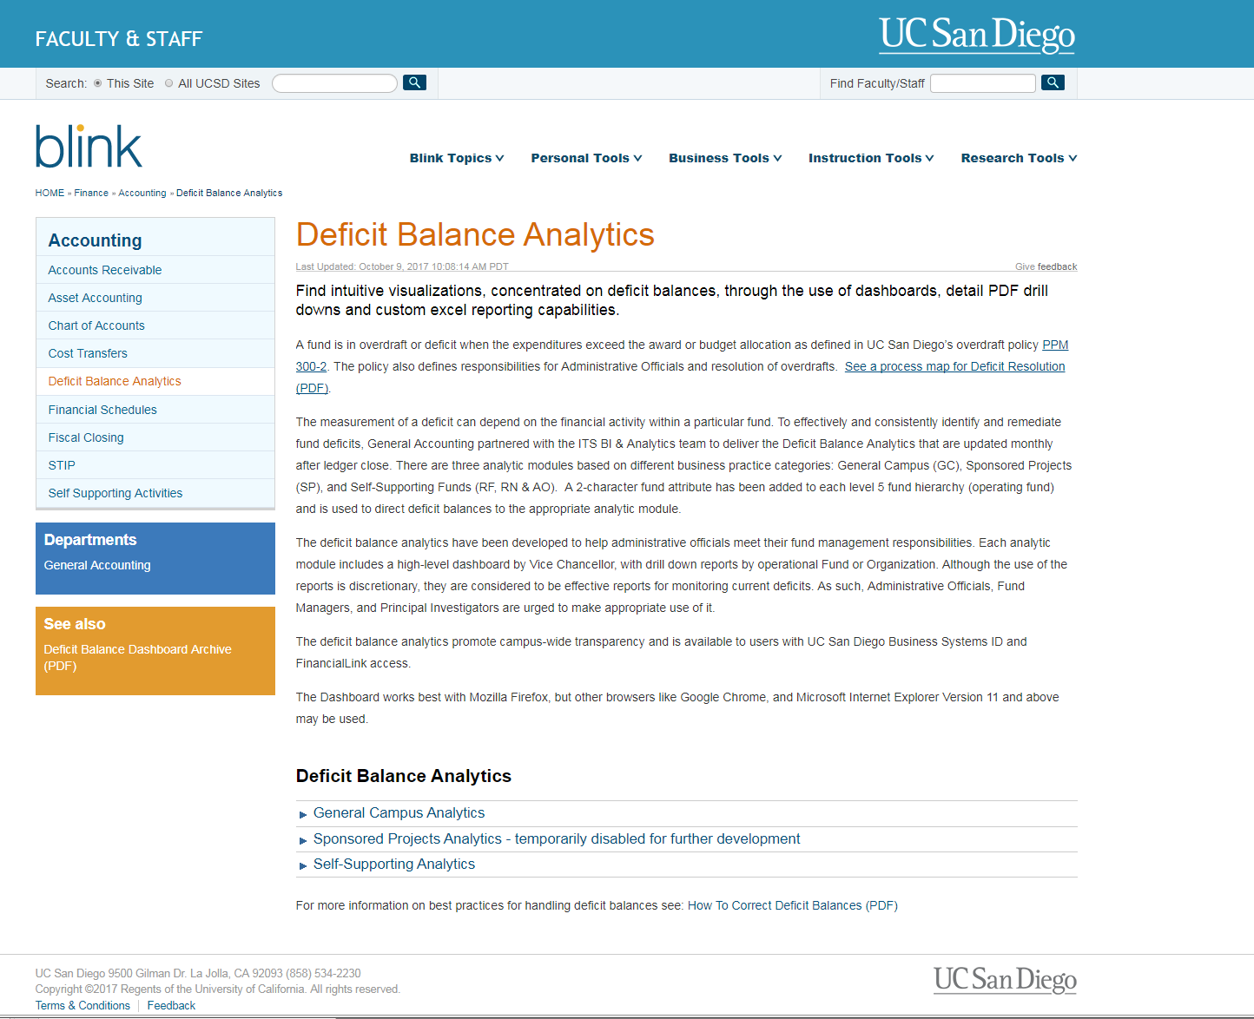
Single Source for Deficit Balance Analytics http://blink.ucsd.edu/finance/accounting/deficit/

Slide 5
Policy: PPM 300-2
First Published February 2017
Revised September 2017
  Internal audit found original version of policy lacked clear accountability and defined process for deficits resolution
  Management agreed to resolution of audit finding by strengthening accountability and defining a clear process to manage timely resolution of existing and future deficits. Required update to 300-2.
  (http://adminrecords.ucsd.edu/PPM/docs/300-2.html)

Slide 6
Overdraft/Deficit Resolution Process
Three Process Routes
  Self Supporting
  Sponsored Projects
  Other Funds

Slide 7
Policy Summary
Funds must be more actively managed to avoid deficits
Resolution plans must be developed and approved
Deficits must be resolved promptly
Deficits should normally be resolved before fiscal year end
  Actively managed deficits may be rolled over to next fiscal year with CFO approval
  Rollover requests consolidated and submitted through Vice Chancellor to Campus Controller for review
  Planned rollover of deficits must be submitted and approved by the CFO before March 31 annually
  Deficits without an approved rollover must be resolved by June 30
  Unresolved deficits/unapproved rollovers at year end will be subject to current or next year budget adjustments

Slide 8
Campus Budget Office Role
Throughout the year, the Campus Budget Office (CBO) will meet with each Vice Chancellor’s financial officers to review existing and anticipated deficits that do not have an approved resolution plan.
Deficit balances that do have long-term resolutions plans will be monitored regularly for progress.
CBO will help financial officers identify fund sources that can be used to clear deficits prior to requesting approval to roll over the overdraft balance into the new fiscal year as outlined in the policy.
As part of the annual budget process, CBO will incorporate these deficit resolution plans and other identified deficit balances into each Vice Chancellor area’s budget review.

Slide 9
Questions

