Slide 1
Academic Affairs Fiscal Contacts Meeting
September 18, 2018
Adam DiProfio, x22565

Slide 2
Today’s Topics
FIS Updates
Apparent awardee & schedule
Guiding Principles
FAQs
Academic Affairs Change Network
Chart of Accounts Cleanup
18/19 EVC Allocation Schedule

Slide 3
Guiding Principles
Design financial processes and reporting to take maximum advantage of new UC San Diego chart of accounts
Maximize configuration options, minimize customizations
Minimize legacy data conversion to new tool
Full functional partnership with Health Sciences in a common financial system and linked chart of accounts
UC San Diego’s internal resources will lead, with external guidance and support from an implementation partner
Adopt and streamline as much out of the box functionality as possible in new financial system, minimize cloning of current processes
Timely adoption of full budget system and the benefits that come with corporate financial planning and associated metrics

Slide 4
Guiding Principles
Meet user needs in the context of what’s best for the institution as a whole
Maximize system’s controls capabilities
Leverage system to stress discipline and accountability in sound financial management of UC San Diego resources
Full and successful integration with defined enterprise systems including student systems (campus and extension) pending future modernization initiatives
Develop and centralize non-student Accounts Receivable with matching to receipts
Develop/modify/extend local financial policies as required to match new core business processes

Slide 5
FAQs
Is there going to be training?
What happens to legacy data?
Is “X” system going away?
Will “X” process change?
Is the index number going away?
Are departmental staff going to be involved?
Are you going to consult me prior to every decision?

Slide 6
Guiding Principles
Design financial processes and reporting to take maximum advantage of new UC San Diego chart of accounts
Maximize configuration options, minimize customizations
Minimize legacy data conversion to new tool
Full functional partnership with Health Sciences in a common financial system and linked chart of accounts
UC San Diego’s internal resources will lead, with external guidance and support from an implementation partner
Adopt and streamline as much out of the box functionality as possible in new financial system, minimize cloning of current processes
Timely adoption of full budget system and the benefits that come with corporate financial planning and associated metrics

Slide 7
Academic Affairs Change Network
http://esr.ucsd.edu/projects/fis.html

Slide 8
Common Chart of Accounts Cleanup
General Accounting creating data pulls to assist with cleanup
Goal – inactivate old index numbers prior to mapping
New Mass Inactivation forms: https://ucsdcloud.sharepoint.com/sites/coa/GAForms_SSO/default.aspx

Slide 9
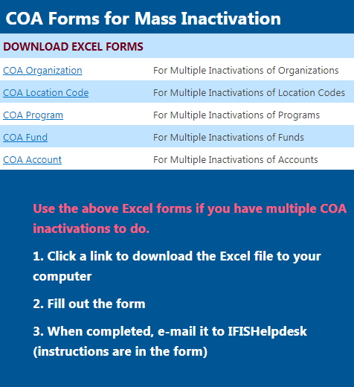

Slide 10
18/19 Allocations
To Divisional Deans:
Divisional Support Model, Temp FTE, TA
Initial models complete. Target - final to Divisions in 2 weeks. Allocations to Departments in October.
To Departments:
Masters Growth & GSGEI
Initial 17/18 adjustments complete. Waiting on Fall 3rd week & October DOPES data. Allocations late Oct/early Nov
New – Block Grant allocation to department
Complete

Slide 11
Thank you.
Adam DiProfio
x22565

