Slide 1
OCGA Presentation - Academic Affairs Fiscal Contacts Meeting
Jeff Warner
Assistant Director
jswarner@ucsd.edu

Slide 2
OCGA Department Model
The OCGA department model is a strategic partnership with our customers. We believe better customer service means being a partner and facilitating research.
This approach is focused on delivering customer-centered research administration services to support your department.
We aim to simplify your interaction with us and increase our mutual engagement through a better understanding of your department’s research portfolio.
Your OCGA Team comprises a Contract & Grant (C&G) Officer, a Senior Contract & Grant Officer, and a Principal Contract & Grant Officer. This structure enhances our ability to manage your research administration needs more effectively.
The launch of Kuali Research is not planned to affect the department model.

Slide 3
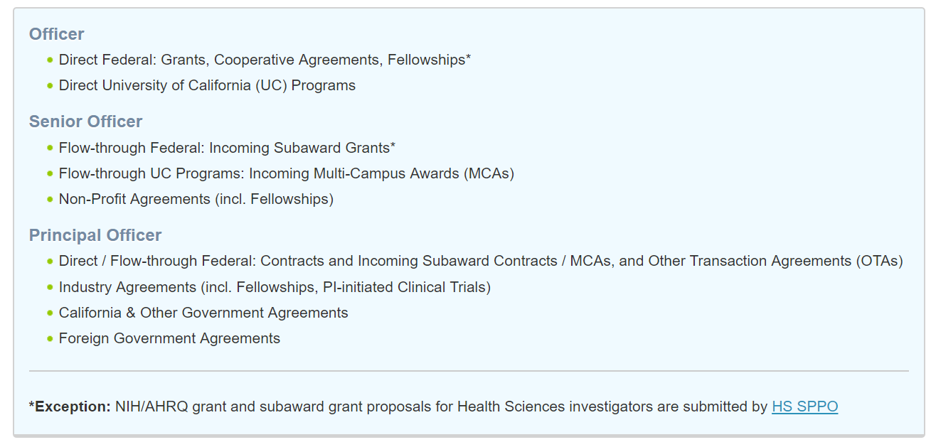
OCGA Department Model

Slide 4
OCGA Unfunded Agreements
OCGA handles unfunded agreements for UCSD, including the following:
Confidential Disclosure/Non-Disclosure Agreements (CDA/NDA) - intended to cover conversations that contain confidential and/or proprietary information from one or both parties and the terms control the disclosure, receipt, and use of the confidential or proprietary information.
Data Use Agreements (DUA) - contract for one party to provide access to, or transfer of, data or a data set to a UCSD principal investigator for research purposes.
Equipment Loan Agreement (ELA) - an agreement between UCSD and another party that allows that party to loan one or more items of equipment to UCSD for research purposes.

Slide 5
OCGA Unfunded Agreements
OCGA handles unfunded agreements for UCSD, including the following:
Memorandum of Understanding (MOU) – an agreement between two or more parties that functions as a more formal alternative to a verbal or "handshake" agreement, also called a Letter of Agreement. An MOU may or may not have the power of a binding contract.
Software Licensing Agreements (SLA) - allows for an outside party to provide use of software to UCSD for research purposes, providing both parties mutual benefit from use of software by UCSD.
Teaming Agreement (TA) - formally acknowledges the relationship and participation of two or more parties who are submitting a proposal for research funding to an outside sponsor, such as the Federal government.

Slide 6
OCGA Unfunded Agreements
The Business Contracts Team strives to initiate negotiation or execution within two to three weeks of receipt.
The Business Contracts Team averaged ~875 unfunded agreements annually over the last three years.
Please complete the unfunded agreement request form: https://blink.ucsd.edu/research/preparing-proposals/sponsors/industry/unfunded-request.html
Please provide all requested information as the form assists your Contract and Grant Officers in understanding what terms are appropriate for the activity and compliance reviews are needed (e.g., export control review).

Slide 7
OCGA Service Agreements
Differential income rates to use for Academic Support and Service Enterprise Activities (Effective July 1, 2010):
On-Campus Service Activities: 45% [Standard], 16% [Minimum]
Off-Campus Service Activities: 22% [Standard], 8% [Minimum]
Ship Use Facilities: 18% [Standard], 6% [Minimum]
Administrative Overhead Recovery Rate to use for Auxiliary Enterprise Activities and Other Income-Producing Activities (Effective July 1, 2018):
Auxiliary Administrative OH Recovery Rate: 4.5% [on current year Revenues]
Educational/Academics OH Recovery Rate: 3.4% [on current year Revenues]
Primary Health Care Administrative OH Recovery Rate: .7% [on current year Revenues]

Slide 8
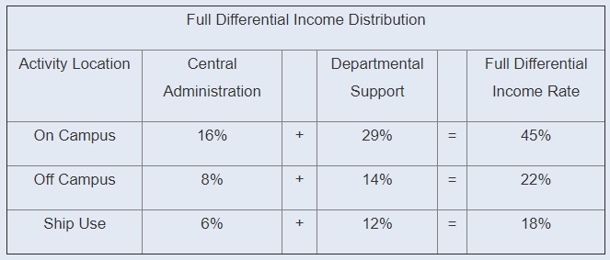
OCGA Service Agreements
In most cases, the Differential Income is to be distributed in two parts:
(1) central administration and (2) departmental support or to the Vice Chancellor responsible for the activity. When an activity has obtained approval from its Vice Chancellor to charge the minimum overhead rate for non-UC sales, the central administration portion must be remitted annually.

Slide 9
OCGA Service Agreements
Overview of Self Supporting Activities
Academic Support Activities normally in funds beginning with 60000a and 65999z (except 63xxxx)
Service Enterprise Activities normally in fund range 60000a-69999z (except 63xxxx funds); funds that are not SSA are also included in this range
Medical Center Activities 63000a-63999z
Labor Clearing Funds normally in fund range 66130a-66170z
Auxiliary Enterprise Activities normally within fund range 70000a-74999z
Other Income-Producing Activities funds normally in fund range 60000a-69999z (except 63xxx funds); funds that are not SSA are also included in this range

Slide 10
OCGA Service Agreements
The operating fund is the accounting mechanism used to record operating costs, UC recharges and income.
For sales to non-UC customers, a revenue account code will be established. A revenue account code is also referred to as an “income account” and generally is a 5 in front of the fund number.
Recharges are income received from charges for sales and services to campus departments or other UC campuses. For University financial reporting, a recharge is considered to be cost redistribution. Therefore, it appears as a credit in the expenditure account code 693900.

Slide 11
OCGA Subrecipient Monitoring
Paying Invoices From Subrecipients
The PI or designee should verify that the expenses are reasonable, allowable, applicable, within the parameters of the sub-award budget, and incurred during the award's performance period.
‘Invoice Approval’ indicates that the goods have been received and/or services have been rendered and the fund source is appropriate.
The ‘Subrecipient Monitoring Approval’ indicates that the costs are reasonable, allowable and allocable within the budget and period of performance.
When a subrecipient invoice is disputed by a department, the invoice document will route to IPPS-Accounts Payable. IPPS-Accounts Payable will notify OCGA’s Business Contracts team to assist with resolution.

Slide 12
OCGA Communication
Please contact me if you have not signed up for the General Campus listerv.
The next OCGA Forum is April 30, 2019 from 9:00 – 10:00 a.m. in the Price Center East Forum Room on the 4th floor.
We are starting to plan our annual Open House. We will be announcing details soon.

Slide 13
OCGA Contact List
Please contact us!
General Proposal & Award Inquiries: OCGAinfo@ucsd.edu
Incoming Service Agreements*: UCSD-provided-svcs@ucsd.edu
Material Transfer Agreements: MTAhelpdesk@ucsd.edu
Outgoing Subawards*: subawards@ucsd.edu
Outgoing MCAs*: multicampusawards@ucsd.edu
Unfunded Agreements*: OCGAcontractsupport@ucsd.edu
OCGA Staff Assignment Tool: https://blink.ucsd.edu/sponsor/ocga/staff-assignments.html

