Slide 1
Academic Affairs Fiscal Contacts Meeting
February 16, 2016
Adam DiProfio
x22565

Slide 2
QueryLink Basics
QueryLink – Web-based tool to retrieve data from the Data Warehouse without knowing SQL programming.
Most “Link Family” sites have a “Queries” link.
Or use DataLink for all Queries

Slide 3
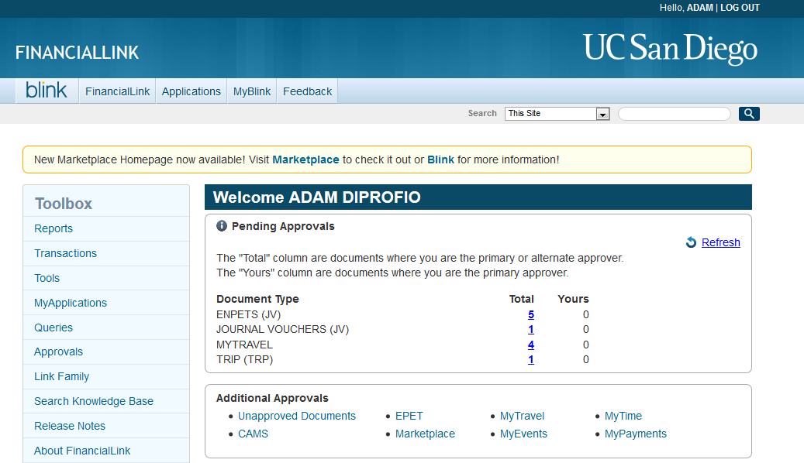

Slide 4
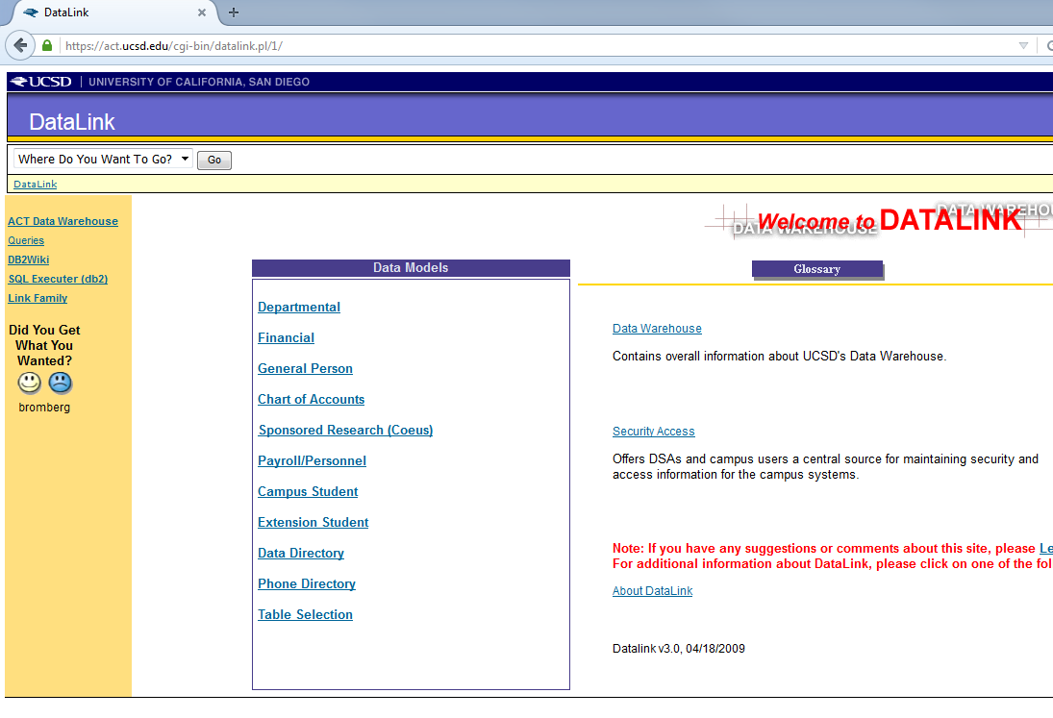

Slide 5
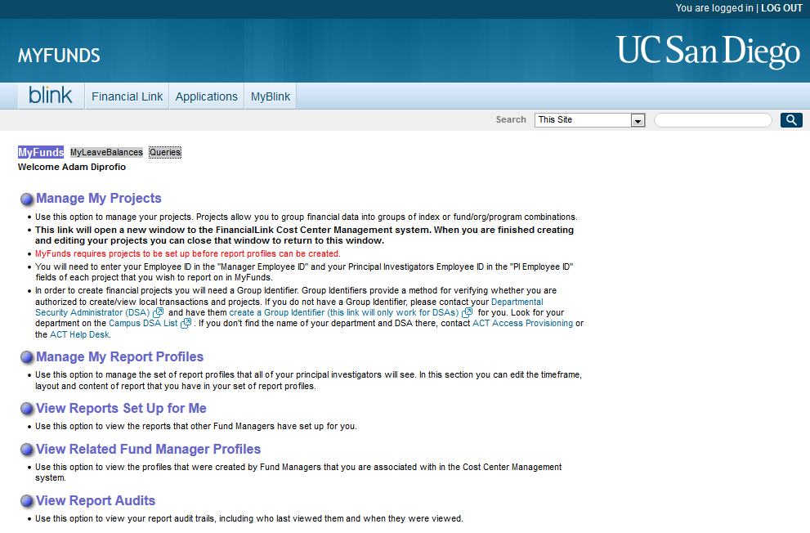

Slide 6
Why Use QueryLink?
If FinLink & Project Numbers are not good enough
Very large data sets
Higher Level Organization Codes
Regularly run complex reports
If there are not good “Link Family” reports
Contracts and Grants
Permanent Budget
Employee Data
Enrollment
If you want to write your own SQL

Slide 7
SQL Basics
SQL Terms
Select
From
Where
Definition
= Display or Report
= Location of Data
= Filter
QueryLink
Check Box
Not Needed
Drop Down List

Slide 8
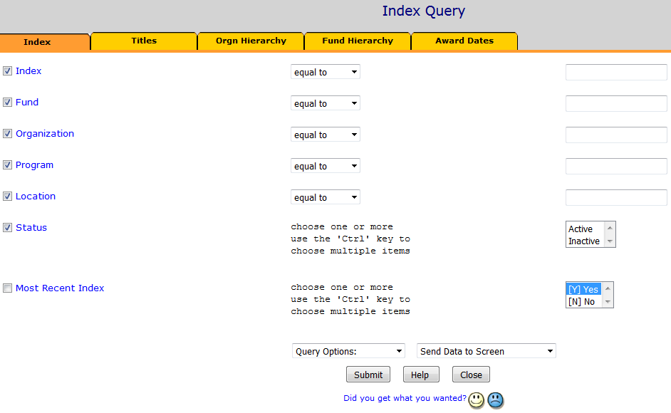
Select / Display
Where / Filter

Slide 9
Sample Queries
Live demos

Slide 10
QueryLink Advanced - Options
View Query – Use to find out why “Your query did not find any results”
Save/Load Query – Store useful & recurring queries. Share with others.
Sort / Subtotal – Can show counts of data and “Only show subtotals”
Turn Distinct On – Important for Contract & Grant or Employee data
Set Results Row Count – Always change this!

Slide 11
QueryLink Advanced - Filters
Equal To / Not Equal To
>= and <=
Contains
Helpful with strong naming conventions
Starts as / starts not as / ends as…
In List
Advanced
Allows 5 of the above filters with and/or options
5 “in list” allows for 50 individual items

Slide 12
Advanced – Increasing Complexity
Individual Accounts = IFOP
Multiple Accounts = Project Numbers
Too complex for Project Numbers = QueryLink filters
Too complex for QueryLink filters = Extract from Data Warehouse using SQL

Slide 13
Advanced – Org Hierarchy
FinancialLink runs as high as Org Level 4
Example Org = 416XXX
QueryLink can go up to Org Level 1
Academic Affairs Depts Typically (but not always):
Org Level 1 = VC Area
Org Level 2 = Division
Org Level 3 = Department
Org Level 4 = FinLink Org

Slide 14
List of helpful queries
Salary info for grant preparers
Replaces the old EmployeeLink general selection
Overdraft Summary Report
Runs Overdraft Report with Notes
Project Detail
Query contents of a Project Number

Slide 15
List of helpful queries
Statement of Operations
Profit/Loss for Recharges/Cost Centers
Accounts Receivable Aging
Track External Payments due
Sponsored Projects AR Aging
Check status of sponsor payments

Slide 16
List of helpful queries
GSRTF Query
Check payments for campus rebates
Approval Templates
DSAs can check IFIS templates
IFIS Unapproved Documents
DSAs can check outstanding documents

Slide 17
List of helpful queries
Proposal Data for Departments
Award Data for Departments
Cost Share Detail
Express Card Transaction
ERS Status Report
Staffing List Detail & Exception
Permanent Budget

Slide 18
Thank you.
Adam DiProfio
x22565

