Slide 1
Academic Affairs Fiscal Contacts Meeting
October 20, 2015
Adam DiProfio
x22565

Slide 2
Today’s Topics
Status of 15/16 allocations
Change in Faculty Salary Exchange Program (FSEP) allocation
Status of new Department Budget Workload Model
Financial Reporting Work Group
Status of Simplified Operating Fund Initiative (SOFI)
Change in practice due to Constructive Receipts
Review of new Endowed Chair Policy effective 1/1/15
Topics and formats for future meetings

Slide 3
15/16 Allocations
Undergraduate Instructional Allocation to be presented to Assistant Deans on 10/21/15
Includes TA, Temp FTE & Instructional Discretionary
Master Growth Incentive
Will replace Grad TA and some block grant & return to aid allocations
Graduate Student Growth Excellence Initiative, GSGEI
15/16 allocations could be reduced by carry forward balances
Request for Report
Equipment Matching
Included in Department Workload Model

Slide 4
Change to Faculty Salary Exchange Program (FSEP)
Prior to 7/1/15 FSEP Salary Savings were retained in the Department and Benefits Savings retained by EVC
Effective 7/1/15 the CFO & EVC agreed to distribute FSEP benefits to Departments
Process
EVC will withdraw quarterly all FSEP salary savings from Departments
EVC will allocate salary and benefits at Academic Composite Benefit Rate to Department index number on Program Code 404000

Slide 5
Change Management
Communication Responsibilities
Management needs to explain:
Business Needs
Alignment with Vision/Strategy
(http://plan.ucsd.edu/) – Goal 5
Risks if we don’t change
Department Supervisors need to:
Ensure Individuals understand the need for change
Assess impact on the Individuals
Assign responsibilities to Individuals
Act as Communication Conduit between Management and Individuals

Slide 6
Change Management - ADKAR
Awareness of the need to change
Desire to participate in & support the change
Knowledge about how to change
Ability to implement new skills & behaviors
Reinforcement to keep the change in place

Slide 7
New Department Budget Workload Model
We don’t have a current clear model
Workgroup started developing a workload-based funding model in 2009
That model was never implemented
Workgroup was reconvened to implement model for 15/16 Department Budget

Slide 8
Budget Model Work Group Members
Adam DiProfio - EVC
Alma Palazzolo - A&H
Anna Gheissari - ORA
Barbara Jackson - Music
Carolyn Sheehan - Nano
Cyndi Muylle - Colleges
Helen Olow - A&H
Jason Yates - PS
Joanna Mancusi - SS
John Bauer - Bio
Maryam Attari - Bio
Peter Hinkley - Psych
Rob Rome - PS
Shanley Miller - Soc.
Steve Ross - EVC
Tana Campana - Eng
Yuki Marsden - QI

Slide 9
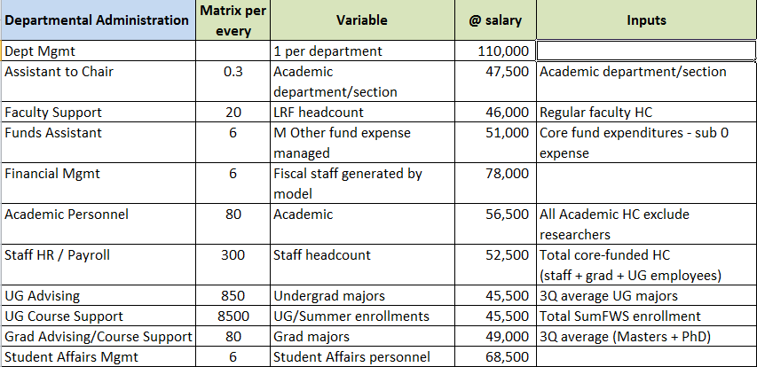
Budget Model - Sample

Slide 10
New Financial Reporting
Current Problem:
Index-level reporting requires department-specific knowledge to categorize activities
Division/VC/Campus roll-up reports are difficult to create and/or unhelpful
Inconsistent reporting among Departments
New Work Group just started looking at creating consistent category levels

Slide 11
Budget Model Work Group Members
Adam DiProfio - EVC
Jason Yates - PS
John Bauer - Bio
Maryam Attari – Bio
Rob Rome - PS
Tana Campana - Eng
Traci Carpenter – OSI/SOFI
Yuki Marsden - QI

Slide 12
Simplified Operating Fund Initiative (SOFI)
Current Problem:
There are 130+ funds used for core operations
Strategic investment becomes dependent on source
Less restrictive funds are often used first
“Color of Money” leads to unnecessary administrative work:
Proliferation of index numbers
Fund swaps
Complicated Project Numbers and Reporting

Slide 13
15/16 Fund Sources for EVC Allocations
Temporary FTE - 19900A
TA FTE – 19900A
Admin Stipends & Ninths – 19900A
Equipment Allocation – 19900A
Equipment Matching – 19933A
Faculty Startup & Retention – 19933A (AH/SS) or combination 19933A/19942A/05397A (Bio/JSOE/PS)
Undergraduate Seminars – 19900A
Graduate Support – 19942A/20095A
Summer Admin Support – 20095A

Slide 14
SOFI Work Group Members
Adam DiProfio - EVC
Ashley Gambhir - OSI
Bill Sweetman - ACT
Daryl James - FAO
Deanna Richardson - Chan.
Greg Buchanan - Audit
Isabella Bryant-Parkinson - HS
Jacob Guss - HS
Karen Andrews - Physics
Kelly Tucker - OSI
Laura Osante - BFS
Mercedes Munoz - Chan.
Paul Rodriguez - BFS
Shanley Miller - Sociology
Steven Ste Marie - GA
Susie Pike Humphrey - SIO
Traci Carpenter - OSI

Slide 15
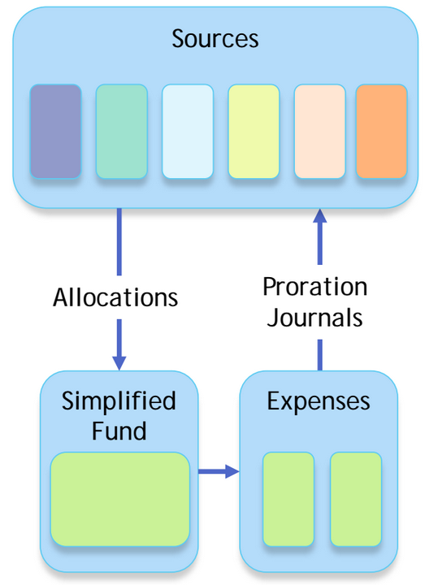
SOFI Plan
Pool “core” campus resources into a simplified fund to support general operations
Maintain fund accounting for revenue streams transparency

Slide 16
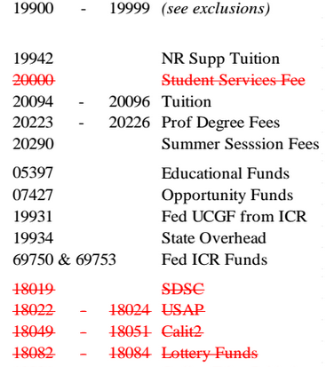
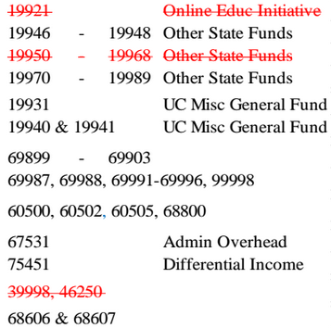
Proposed Fund Numbers

Slide 17
Constructive Receipts
DEFINITION of 'Constructive Receipt‘ - A tax term mandating that a taxpayer is liable for income, which has not been physically received, but has been credited to the taxpayer's account or otherwise becomes available for him or her to draw upon in the future.

Slide 18
Campus Response
From 7/1/15 email – “Due to constructive receipt concerns, as of July 1, 2015, requests to redirect compensation to research accounts will no longer be considered. Administrative stipends, summer salary, and any other compensation must be paid through the Payroll/Personnel System.”
Will also possibly affect Coursera / MOOC payments

Slide 19
New Endowed Chair Policy
See presentation from May 5, 2015:
http://aba.ucsd.edu/_files/2015.05-EndowedChairs.pdf
Effective for new chairs appointed after 1/1/15:
Chair term = 5 years and renewable
1st $25K will be for chair holder’s “scholarly allowance”
Remaining balance is for department use of chair holder salary and/or grad fellowships

Slide 20
15/16 Fiscal Contacts Meetings
Upcoming Topics
November 17 – Connexxus and UCOP Travel Programs by Yasmin Sidi
What other topics, formats or speakers would you like to see?

