Slide 1
Enterprise Systems Renewal - RESEARCH
Academic Affairs Fiscal Contacts
October 17, 2017

Slide 2
Agenda
Quick Introductions
More on ESR…

Slide 3
What is ESR?
The Enterprise Systems Renewal program is an initiative that will transform core business and administrative processes across campus… it is the largest process and technology improvement program ever undertaken at UC San Diego.

Slide 4




An iterative approach that is not focused on replacing systems
We are here!
Observe/discover the present state UC San Diego mission critical processes
Orient findings based on the strategic value and evolving culture
Decide on processes and underlying technology that will be renewed and sequencing of events
Act with precision to reengineer processes and deploy new solutions to achieve desired outcomes
Deliverables: Inventory of processes, interfaces, applications and data hierarchies.
Deliverables: Identification and confirmation of process friction, scope of impact and strategic value.
Deliverables: Analysis of market supply and maturity, target modules and 50-50 estimate budget for renewal.
Deliverables: Plan for, select, build/integrate, test and deploy targeted solutions.

Slide 5
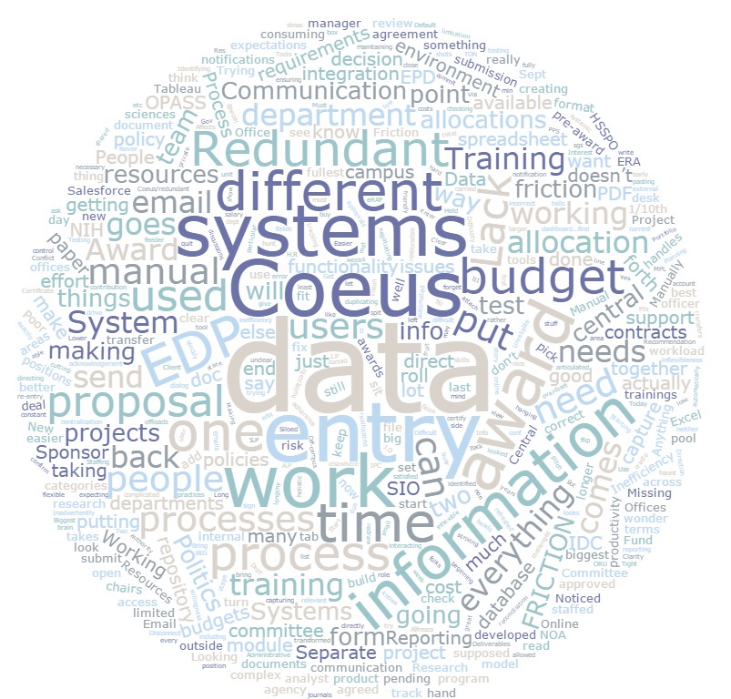
Top Research Friction Points
  We work for the systems, the systems don’t work for us
  Lack of system integration
  Lack of system automation
  Redundant data entry across systems
  Workflow and workload management tools

Slide 6
We work for the systems, the systems don’t work for us
Friction Description
Quotes
The most common friction point received during the process review is that stakeholders do not feel as if the systems are supporting their work and areas of responsibilities. They expressed frustration that systems have been developed in isolation by individuals unfamiliar with the ways in which they do business and without a focus on their functional needs.
Business Impact:
Minimum capabilities
Inconsistencies in data
Redundancies in data entry and maintenance
Difficultly tracking information
Lack of access to data, e.g. reports
Maintenance of information, where it should be logged and where it can be found, is a great concern
Too many people involved and ambiguity surrounding distribution of responsibilities
"We work for the system, however the system doesn't work for us"
“Systems are not used to full potential, are outdated, and are not user friendly”
"Inability to get accurate day to day operational costs and inability to project... those are make or break parts of science"
“The RSC people are essentially doing it by hand.”
"The University should focus on making sure current systems are efficient before adding more"
"The current systems in place make my job more difficult, more time intensive, and almost impossible to complete tasks"
"My software at home is easier to use and has more functionality than the systems I am required to use at work"
Notes:
Frictionaires: Difficulty Using Current System
Many reported that their jobs are not made difficult by the current systems, the systems just make their jobs more time intensive and are not optimally effective.
With proper training, using the systems is very doable.
However, one person reported that the current system makes their job impossible and others reported the system makes their job unclear.
One common difficulty reported is tracking data - where to find it and where to record it.
Friction by System: Coeus
Progress Reporting including Sponsor Reporting
If in Coeus you could put attachments – not available in the proposal tracking module – IP part the only time they put anything in there is if the budget has been revised.
Requesting access for those who don't have it
Not enough data fields – not capturing all of the data we need
Can't capture our work load
No way to capture our awards

Slide 7
Lack of system integration
Friction Description
Quotes
At the current time the majority of systems supporting research administration do not share or communicate information. This leads to reported issues with data integrity, increased effort for data maintenance, and shadow systems developed in isolation to fill needs not met.
Business Impact:
Manual data transfers due to lack of system functionality leads to data entry errors and considerable demands on time to identify and resolve errors
End user system satisfaction is low and impacts their ability to conduct their work efficiently and accurately. Though not an issue at this time, future employee retention could be impacted through decreased work satisfaction
The number of systems in use comes at a high cost in terms of training and developing new employees. Feedback indicates it can take over 1 year to onboard a new fund manager to directly support research personnel
Shadows systems are in wide use to cover gaps in system integration and communication
“Things do not move from ePD to the IP module and then from IP to the Award module, so we enter the same thing several times.”
“In and out of all these different systems all day long”
“There are so many systems and tools and forms”
“[too many] Silos – bring all best processes together”
“Get the inductive process to flip and become deductive.”
“Have to run multiple financial reports to get all data needed to do job. many duplicative reports, hard to know best ones to use.”
“…info from ePD is re-provided via email. Info from COA is re-entered into division tool.”
"Our systems and processes at UCSD are very depended on the people, and not necessarily stand alone.“
Notes:
“Our current financial reports we key data from Finlink to excel, or PI's request customizable reports that we have to re-key from finlink, re-key proposal data into ASSIST.”
“Coeus proposal data into award set up document, Coeus proposal and award data into Notice of Award and Approval, Coeus award data into distribution communications during award life cycle.”
“When working in ePD, Coeus, and the eMTA system. For example, we need to finalize ePD proposals in Coeus by having to manually enter data.”
“Coeus proposal data into award set up document, Coeus proposal and award data into Notice of Award and Approval, Coeus award data into distribution communications during award life cycle.”
“Budgets are manually created using sponsor forms and the key info from those forms is then manually re-keyed into Coeus.”
From systems to worksheet to reports; not all data in pre-award (coeus) to then flow to customers. Multiple systems used to communicate data that could have been done at beginning; rekey because online system (JV2.0) taken down.”
“Service contracts - data originals are via PDF, need to manually enter into online database.”
Frictionaires: Does your systems cause excessive rework?
Those who stated that systems do cause excessive rework reported the following as core reasons:
“Manual adjustments of reports downloaded from finlink.”
“Incomplete requirements, poor understanding of business processes by SMEs & technical staff, incomplete/insufficient unit and regression testing.”
“Coeus system often 'forgets to save' configuration changes resulting in two people having to do the same work (one does the entry and saves it, while the other double checks to make sure the system actually saved it).”
“It lacks capability and as a result, require staff to work outside of the system.”
“Updating and fixing.”
“To move data from one system to worksheet to report is duplicative; transactions can hit funds when shouldn't (payroll even if fund closed, travel, vendor credits, vacation usage); revisit to closeout because couldn't do all transaction timely (month end closing can delay processing for multiple months).”

Slide 8
Lack of system automation
Friction Description
Quotes
The majority of stakeholder respondents shared the perspective that there are multiple manual, redundant data entry points for maintaining information across all systems. Stakeholders indicated that the majority of systems do not communicate data to each other precipitating the redundant data entry. In addition, it was reported many fields within the range of systems do not auto populate or auto calculate information.
Business Impact:
This issue comes at a high cost in terms of financial support for personnel (both central and college level) to maintain data and shadow systems developed to cover gaps in system automation;
Stakeholders with already high workloads are wasting limited time on data entry, reducing focus on activities that have the potential to generate funding (proposals) and activities related to the management of existing awards;
Gaps in communication during the proposal development/review process can result in data errors and/or omissions, as can redundant data entry;
A disproportionate number of new awards set up in the system have errors.
On average, “4 awards out [of every] 10 have problems related to data accuracy for award setup”
“Systems don't validate against other systems”
“…info from ePD is re-provided via email. Info from COA is re-entered into division tool.”
“For our current financial reports we key data from Finlink to excel, or PI's request customizable reports that we have to re-key from finlink, [we also have to] re-key proposal data into ASSIST.”
“When working in ePD, Coeus, and the eMTA system. For example, we need to finalize ePD proposals in Coeus by having to manually enter data.”
“Service contracts - data originals are via PDF, need to manually enter into online database.”
“Budgets are manually created using sponsor forms and the key info from those forms is then manually re-keyed into Coeus.”

Slide 9
Redundant data entry across systems
Friction Description
Quotes
Stakeholder feedback had near unanimous consent that there are too many systems requiring duplicate data entry. The current application environment burdens administrator time, reduces data accuracy, and results in repeated error validation and correction tasks.
Business Impact:
Reduced efficiency
Challenges in maintaining data integrity
Reduced employee satisfaction and Investigator engagement
Lack of detailed budgeting in the eRA system and system inability to migrate data to the financial system(s) results in the completion of detailed budgeting a minimum of 4 times in order to get a proposal submitted and an award established. This does not include budget entry in shadow systems which is a common occurrence as well.
Increased financial and regulatory compliance risk
“[ePD is] not time saving, takes longer than a paper process.”
“Currently easier to send a PDF then go from tab to tab in Coeus… would be easier to attach the award doc in Coeus”
“Transferring information from EDP to Coeus – some information/items do not transfer over as they should… manually re-typing of information into Coeus … ex. IDC role shouldn't have to be retyped”
“Have to manually move things around for the sponsors – leads to a manual risk ”
“Cost share doesn't have details of breakdown so have to manually add things – manual changes we need to do for the requirements necessary – only way to get invoices paid. ”
“Budgets are manually created using sponsor forms and the key info from those forms is then manually re-keyed into Coeus.”

Slide 10
Workflow and workload management tools
Friction Description
Quotes
Respondents expressed challenges in managing their workload and with the workflow notification functionality in existing systems. Many of the Colleges have, or are in the process of, developing solutions for managing and aligning work priorities. Researchers expressed frustration with the workflow notification systems, particularly with it's lack of flexibility for inserting additional reviewers.
Business Impact:
Individuals are challenged in managing their volume of work and the prioritization of that work, leading to potential gaps in timely resolution of critical, time sensitive actions.
Leadership is relegated to manually tracking workload distribution and utilizing shadow systems to solve problems.
Potential to redeploy and align staff members during high volume periods (I.e. Federal deadlines, month end close, fiscal year end close, etc...).
Gaps in services and non-compliance with regulations are potential issues that can have true financial implications on spending and managing awards
“HSPPO and OCGA have separate policies and procedures”
“by not forcing conformity, everyone is off doing their own thing which I think slows progress down.”
“The root of the problem we have on this campus is that no one is accountable.”
“Clinical trails are in two pots, commercial and investigator initiated, I think they should be done in one office in HS, not OCGA.”
“We would get checks – we wouldn’t know who the checks belonged to – so we would put them on an electronic bulletin board”
"Technically I have four bosses, but only one that is authorized"
“Closeouts - they are not happening… there is no accountability“

Slide 12
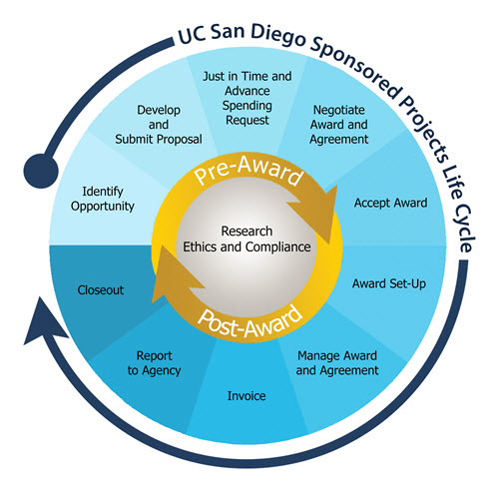
KUALI RESEARCH
Proposal and Award
Manage proposals after submission and before award
Create proposal, budget development, internal review/approval and submit to sponsor
Negotiate terms and conditions
Award creation
Setup award periods (dates & dollars). Integration with UCSD financial systems
Close award after all final deliverables have been provided to sponsor
Manage the research/award conducted over time (award budget, non-expenditure)
Track reports due to sponsor

Slide 13
ESR PROGRAM STRUCTURE
IT Governance
Enterprise Information Services Committee (EISC)
Financial | Human Resources | Research | Student | Health (UCSD/UCI) | UCPath
Laurie Owen, AVC, Research
Daric Brummett, Executive Director, Advancement
Cathy Ledford, Chief HR Officer, Campus
Janet Kamerman, Chief HR Officer, Health
Cheryl Ross, AVC Controller
Mark Cunningham, AVC Housing Dining Hospitality
Juan Gonzalez, VC Student Affairs
Gene Hasegawa, COO Health Sciences
Bill Hodgekiss, Sr. AVC Academic Planning
Steve Gallagher, AVC Scripps Institution of Oceanography
Gary Matthews, VC RMP
Steve Ross, AVC Academic Resources
Adele Brumfield, AVC Enrollment Management
Lori Donaldson, CFO Medical Center
Kevin Chou, Executive Director ITS
Pierre Ouillet, VC CFO
ESR Program Team
Procurement
Ted Johnson, Chief Proc. Officer
Todd Adams, Director P&C
Linda Luna, Strategic Sourcing
Mary Chiu, RFx Coordinator
Architecture & Program Mgmt
Scott Lee, Enterprise Architect
David Hutches, Data Architect
Kal Zsamboky, ITS PMO
Kevin Chou
ESR Director
Change Facilitation
Steve Ross, AVC Academic Resources
Don Portugal, Director Medical Center Business Applications
Kevin Chou, ESR Director
Marketing, Communication & Training
Jessica Hilt, Marketing Lead
Elaine Fleming, Communications
Jade Griffin, UCPA
Bernadette Han, Strategic CM
ESR Project Teams
Change Lead
Build Lead
Technical Lead
Project Manager
ESR-Student/Academic
Cindy Palmer, AVC APS
Brandy Cheshire, APS Anlyst.
Jonathan Whitman, Dir. SIS
Sandra Titus, ITS
John Lane, ITS
ESR-Human Resources
TBD, Change Lead
TBD, Build Lead
Brian Lorentz, Assist. Dir. HRIS
Jude Poole, Dir. Biological Sciences IT
Rosemarie Del Mar, ITS
ESR-Finance
Arlynn Renslow, Dir. General Acc.
Adam Diprofio, Dir. Academic Fin.
Bill McCarroll, Sr. Dir. General Acc.
Bill Sweetman, Dir. FIS/HRIS
Kal Zsamboky, ITS (Interim)
ESR-Research
TBD, Change Lead
Jason DeFay, e-Research Admin.
Sandon Jurowski, Assist. Dir. RIS
Susan Oswalt, ITS
ESR-UCPath
Pearl Trinidad, Exec. Dir. BFS
Jennifer Kramer, Assist. Dir. FIS
Beatrice Dormoy, ITS
ESR-Capital Asset Management
Vladimir Orlic, Asst. Dir. RMPIS
Kirk Belles, Space Management Anlyst.
Mary Ann Martel, Real Estate Anlyst.
Wendy Schiefer, Mgr. Fac. Mgmt.
Barry Peters, ITS
ESR-Analytics
Brett Pollak, Dir. Workplace Tech Services
Judy White, Assist. Dir. Bus. Intel.
Mara Cadagas, ITS
ESR-IT/Technical Change
Mojgan Amini, Dir. ITS Project Management and Continuous Improvement
ESR-HyperCare
Chris Rice, Experience Architect
Chris Ranglas, ITS
ESR-Integration Platform
TBD, Tech Lead
Dennis Fox, ITS
ESR-Identity/Access Management
Roger Phillips, Assist. Dir. ID/AM
TBD, ITS

Slide 14
Find out more @ esr.ucsd.edu
Website soft launched: September 18, 2017

